Slide 1
The Special
Senses: Part C

Slide 2
The Chemical Senses: Smell And Taste
Smell (olfaction) and taste (gustation)
Chemoreceptors respond to chemicals in aqueous solution

Slide 3
Olfactory Epithelium and the Sense of Smell
Olfactory epithelium in roof of nasal cavity
  Covers superior nasal conchae
  Contains olfactory sensory neurons
    Bipolar neurons with radiating olfactory cilia
    Supporting cells surround and cushion olfactory receptor cells
  Olfactory stem cells lie at base of epithelium
Bundles of nonmyelinated axons of olfactory receptor cells form olfactory nerve (cranial nerve I)

Slide 4
Olfactory Sensory Neurons
Unusual bipolar neurons
  Thin apical dendrite terminates in knob
  Long, largely nonmotile cilia (olfactory cilia) radiate from knob
    Covered by mucus (solvent for odorants)
  Olfactory stem cells differentiate to replace them

Slide 5
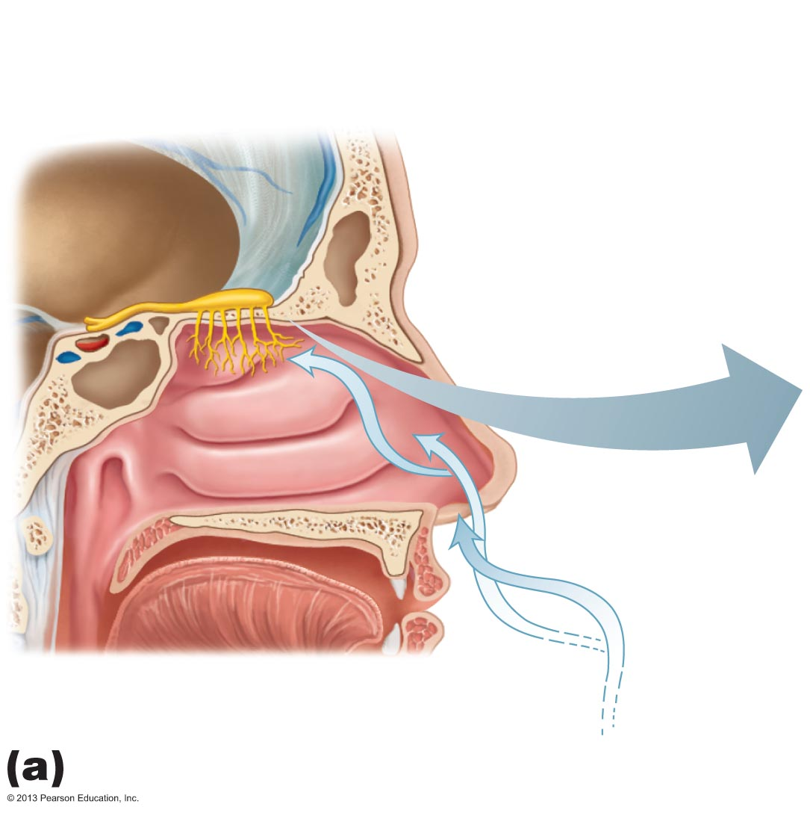
Figure 15.20a Olfactory receptors.
Olfactory
epithelium
Olfactory tract
Olfactory bulb
Nasal
conchae
Route of
inhaled air

Slide 6
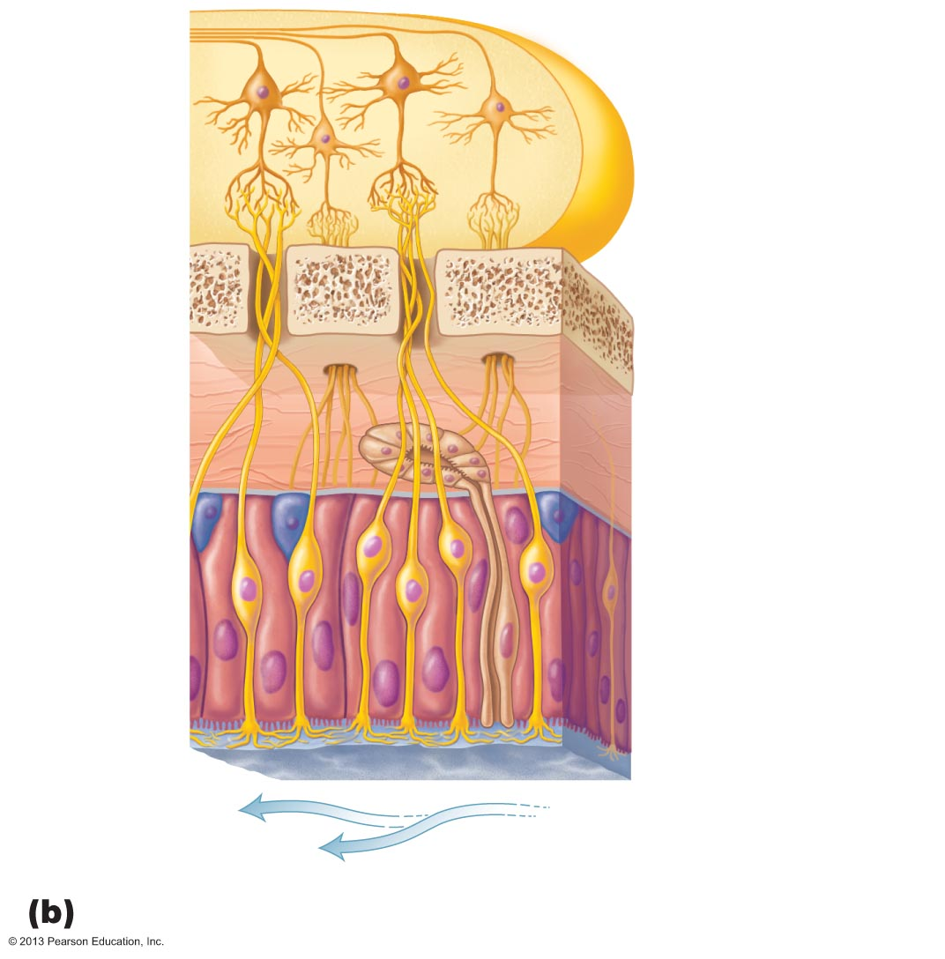
Figure 15.20b Olfactory receptors.
Olfactory
tract
Mitral cell
(output cell)
Glomeruli
Olfactory bulb
Cribriform plate
of ethmoid bone
Filaments of
olfactory nerve
Lamina propria
connective tissue
Olfactory
gland
Olfactory axon
Olfactory stem cell
Olfactory sensory
neuron
Olfactory
epithelium
Supporting cell
Dendrite
Mucus
Olfactory cilia
Route of inhaled air
containing odor molecules

Slide 7
Specificity of Olfactory Receptors
Humans can distinguish ~10,000 odors
~400 "smell" genes active only in nose
  Each encodes unique receptor protein
    Protein responds to one or more odors
  Each odor binds to several different receptors
  Each receptor has one type of receptor protein
Pain and temperature receptors also in nasal cavities

Slide 8
Physiology of Smell
Gaseous odorant must dissolve in fluid of olfactory epithelium
Activation of olfactory sensory neurons
  Dissolved odorants bind to receptor proteins in olfactory cilium membranes

Slide 9
Smell Transduction
Odorant binds to receptor → activates G protein
G protein activation → cAMP (second messenger) synthesis
cAMP → Na⁺ and Ca²⁺ channels opening
Na⁺ influx → depolarization and impulse transmission
Ca²⁺ influx → olfactory adaptation
  Decreased response to sustained stimulus

Slide 10
Olfactory Pathway
Olfactory receptor cells synapse with mitral cells in glomeruli of olfactory bulbs
Axons from neurons with same receptor type converge on given type of glomerulus
Mitral cells amplify, refine, and relay signals
Amacrine granule cells release GABA to inhibit mitral cells
  Only highly excitatory impulses transmitted

Slide 11
The Olfactory Pathway
Impulses from activated mitral cells travel via olfactory tracts to piriform lobe of olfactory cortex
Some information to frontal lobe
  Smell consciously interpreted and identified
Some information to hypothalamus, amygdala, and other regions of limbic system
  Emotional responses to odor elicited

Slide 12
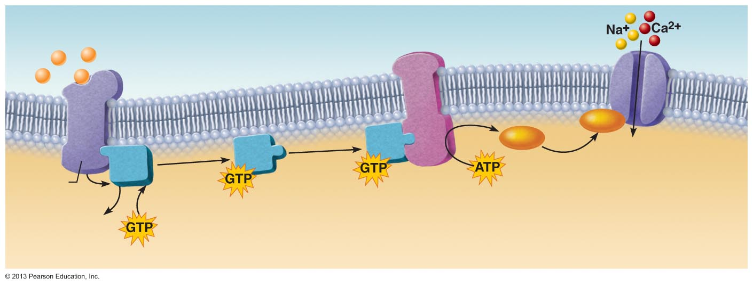
Figure 15.21 Olfactory transduction process.
Slide 1
Odorant binds
to its receptor.
1
Odorant
Adenylate cyclase
G protein (G_{olf})
cAMP
cAMP
Open cAMP-gated
cation channel
Receptor
GDP
Receptor
activates G
protein (G_{olf}).
G protein
activates adenylate
cyclase.
Adenylate cyclase converts ATP to cAMP.
cAMP opens a cation channel, allowing Na⁺ and Ca²⁺ influx and causing depolarization.
2
3
4
5

Slide 13
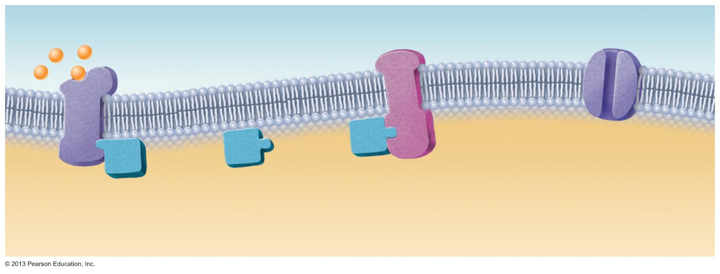
Figure 15.21 Olfactory transduction process.
Slide 2
Odorant binds
to its receptor.
1
Odorant
Receptor

Slide 14
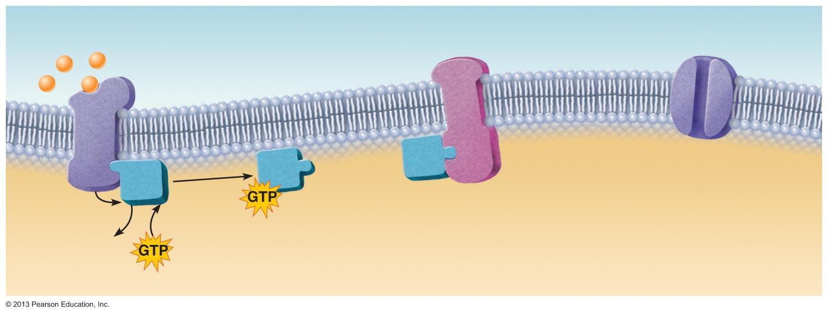
Figure 15.21 Olfactory transduction process.
Slide 3
Odorant binds
to its receptor.
1
Odorant
G protein (G_{olf})
Receptor
GDP
Receptor
activates G
protein (G_{olf}).
2

Slide 15
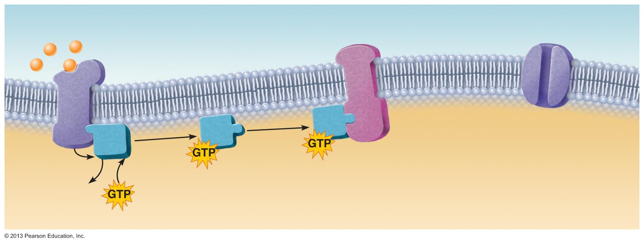
Figure 15.21 Olfactory transduction process.
Slide 4
Odorant binds
to its receptor.
1
Odorant
Adenylate cyclase
G protein (G_{olf})
Receptor
GDP
Receptor
activates G
protein (G_{olf}).
G protein
activates adenylate
cyclase.
2
3

Slide 16
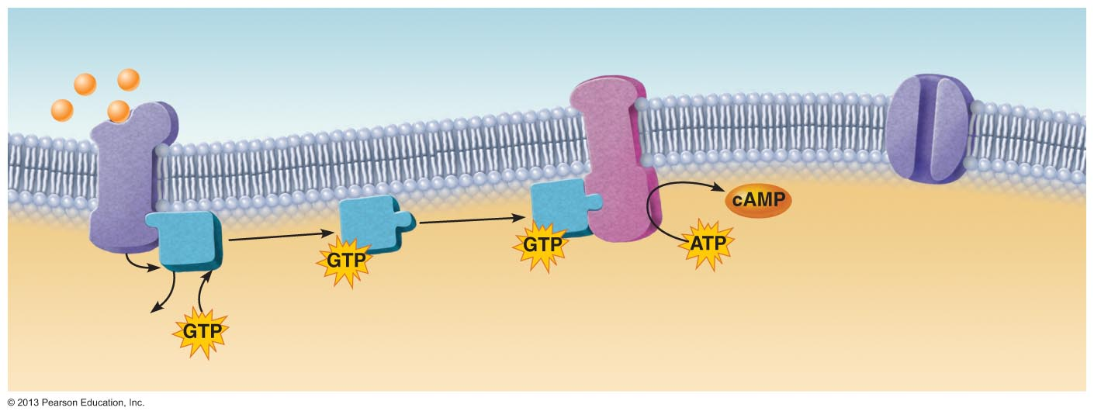
Figure 15.21 Olfactory transduction process.
Slide 5
Odorant binds
to its receptor.
1
Odorant
Adenylate cyclase
G protein (G_{olf})
Receptor
GDP
Receptor
activates G
protein (G_{olf}).
G protein
activates adenylate
cyclase.
Adenylate cyclase converts ATP to cAMP.
2
3
4

Slide 17
Figure 15.21 Olfactory transduction process.
Slide 6
Odorant binds
to its receptor.
1
Odorant
Adenylate cyclase
G protein (G_{olf})
cAMP
cAMP
Open cAMP-gated
cation channel
Receptor
GDP
Receptor
activates G
protein (G_{olf}).
G protein
activates adenylate
cyclase.
Adenylate cyclase converts ATP to cAMP.
cAMP opens a cation channel, allowing Na⁺ and Ca²⁺ influx and causing depolarization.
2
3
4
5

Slide 18
Taste Buds and the Sense of Taste
Receptor organs are taste buds
  Most of 10,000 taste buds on tongue papillae
    On tops of fungiform papillae
    On side walls of foliate and vallate papillae
  Few on soft palate, cheeks, pharynx, epiglottis

Slide 19
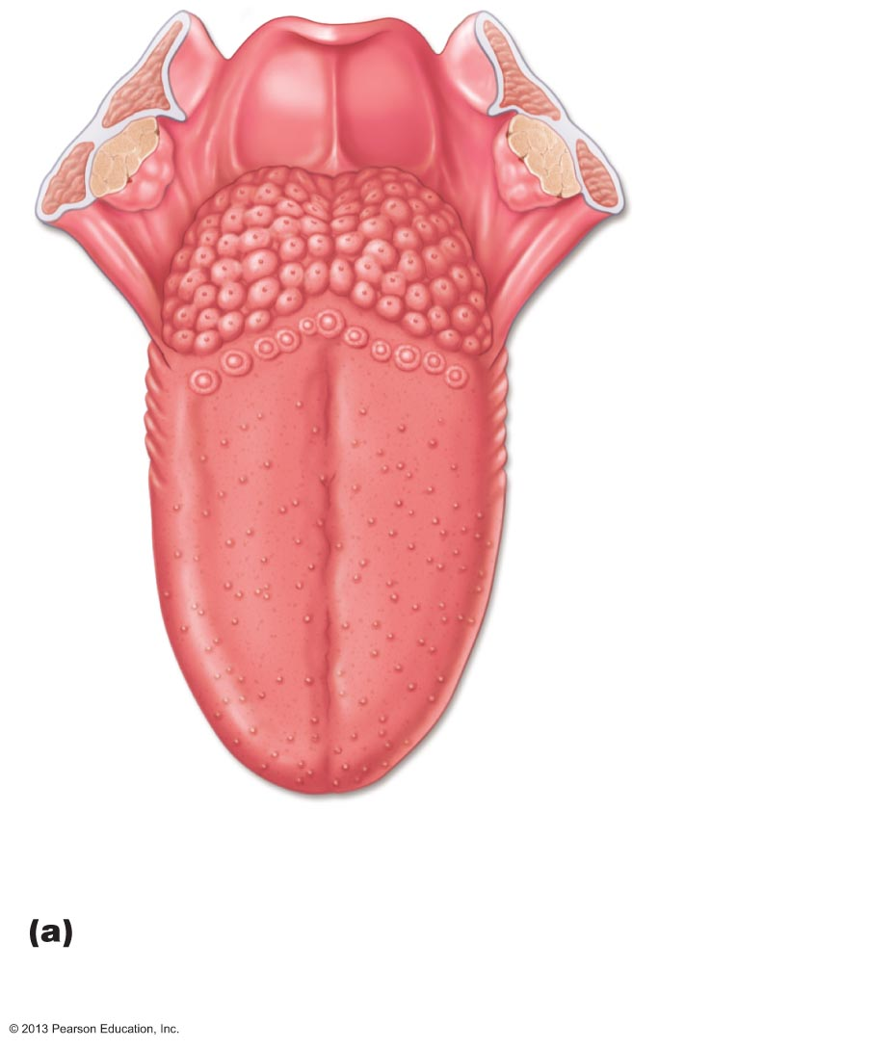
Figure 15.22a Location and structure of taste buds on the tongue.
Epiglottis
Palatine tonsil
Lingual tonsil
Foliate
papillae
Fungiform
papillae
Taste buds are associated
with fungiform, foliate, and
vallate papillae.

Slide 20
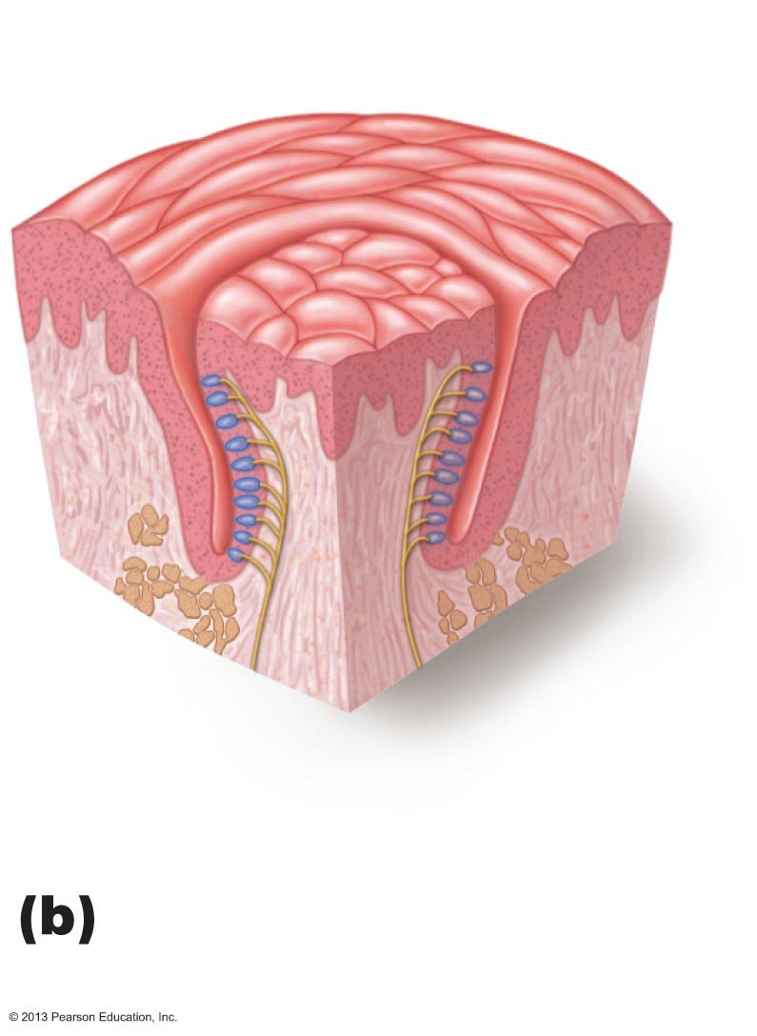
Figure 15.22b Location and structure of taste buds on the tongue.
Vallate papilla
Taste bud
Enlarged section of a
vallate papilla.

Slide 21
Structure of a Taste Bud
50–100 flask-shaped epithelial cells of 2 types
  Gustatory epithelial cells—taste cells
    Microvilli (gustatory hairs) are receptors
    Three types of gustatory epithelial cells
      One releases serotonin; others lack synaptic vesicles but one releases ATP as neurotransmitter
  Basal epithelial cells—dynamic stem cells that divide every 7-10 days

Slide 22
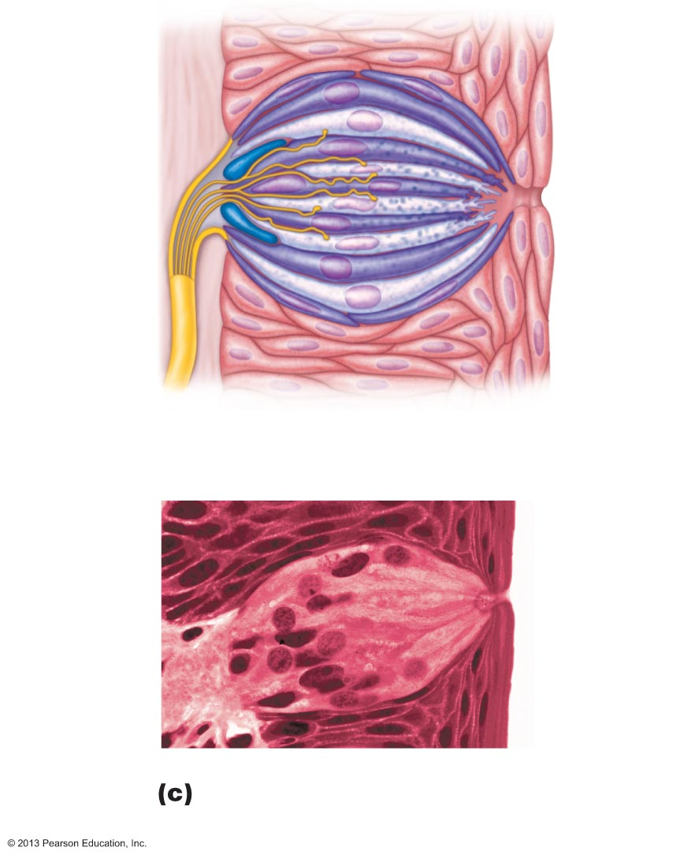
Figure 15.22c Location and structure of taste buds on the tongue.
Connective
tissue
Gustatory
hair
Taste fibers
of cranial
nerve
Basal
epithelial
cells
Gustatory
epithelial
cells
Taste
pore
Stratified
squamous
epithelium
of tongue
Enlarged view of a taste
bud (210x).

Slide 23
Basic Taste Sensations
There are five basic taste sensations
  Sweet—sugars, saccharin, alcohol, some amino acids, some lead salts
  Sour—hydrogen ions in solution
  Salty—metal ions (inorganic salts)
  Bitter—alkaloids such as quinine and nicotine; aspirin
  Umami—amino acids glutamate and aspartate

Slide 24
Basic Taste Sensations
Possible sixth taste
  Growing evidence humans can taste long-chain fatty acids from lipids
  Perhaps explain liking of fatty foods
Taste likes/dislikes have homeostatic value
  Guide intake of beneficial and potentially harmful substances

Slide 25
Physiology of Taste
To taste, chemicals must
  Be dissolved in saliva
  Diffuse into taste pore
  Contact gustatory hairs

Slide 26
Activation of Taste Receptors
Binding of food chemical (tastant) depolarizes taste cell membrane → neurotransmitter release
  Initiates a generator potential that elicits an action potential
Different thresholds for activation
  Bitter receptors most sensitive
All adapt in 3-5 seconds; complete adaptation in 1-5 minutes

Slide 27
Taste Transduction
Gustatory epithelial cell depolarization caused by
  Salty taste due to Na⁺ influx (directly causes depolarization)
  Sour taste due to H⁺ (by opening cation channels)
  Unique receptors for sweet, bitter, and umami coupled to G protein gustducin
    Stored Ca²⁺ release opens cation channels → depolarization → neurotransmitter ATP release

Slide 28
Gustatory Pathway
Cranial nerves VII and IX carry impulses from taste buds to solitary nucleus of medulla
Impulses then travel to thalamus and from there fibers branch to
  Gustatory cortex in the insula
  Hypothalamus and limbic system (appreciation of taste)
Vagus nerve transmits from epiglottis and lower pharynx

Slide 29
Role Of Taste
Triggers reflexes involved in digestion
Increase secretion of saliva into mouth
Increase secretion of gastric juice into stomach
May initiate protective reactions
  Gagging
  Reflexive vomiting

Slide 30
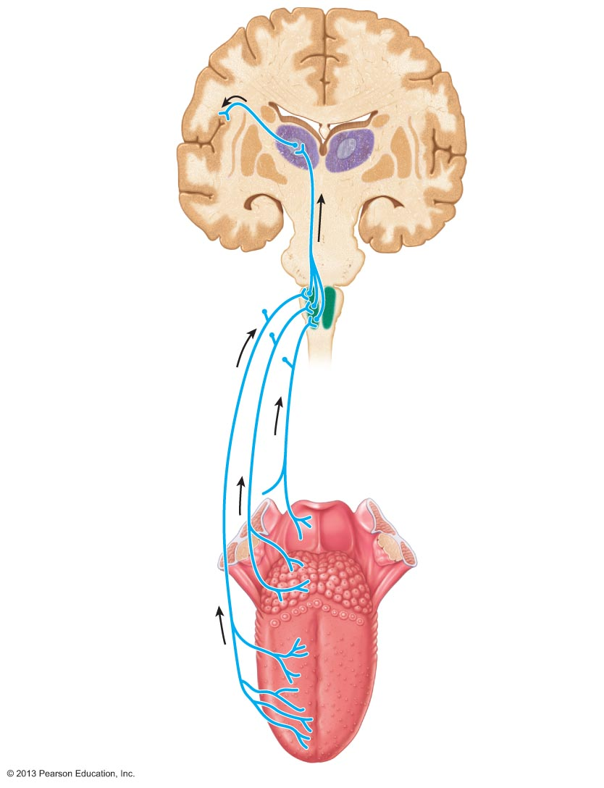
Figure 15.23 The gustatory pathway.
Gustatory
cortex
(in insula)
Thalamic
nucleus
(ventral
posteromedial
nucleus)
Pons
Solitary nucleus
in medulla
oblongata
Facial
nerve (VII)
Vagus nerve (X)
Glossopharyngeal
nerve (IX)

Slide 31
Influence of other Sensations on Taste
Taste is 80% smell
Thermoreceptors, mechanoreceptors, nociceptors in mouth also influence tastes
  Temperature and texture enhance or detract from taste

Slide 32
Homeostatic Imbalances of the Chemical Senses
Anosmias (olfactory disorders)
  Most result of head injuries and neurological disorders (Parkinson's disease)
  Uncinate fits – olfactory hallucinations
    Olfactory auras prior to epileptic fits
Taste problems less common
  Infections, head injuries, chemicals, medications, radiation for CA of head/neck

Slide 33
The Ear: Hearing and Balance
Three major areas of ear
  External (outer) ear – hearing only
  Middle ear (tympanic cavity) – hearing only
  Internal (inner) ear – hearing and equilibrium
    Receptors for hearing and balance respond to separate stimuli
    Are activated independently

Slide 34
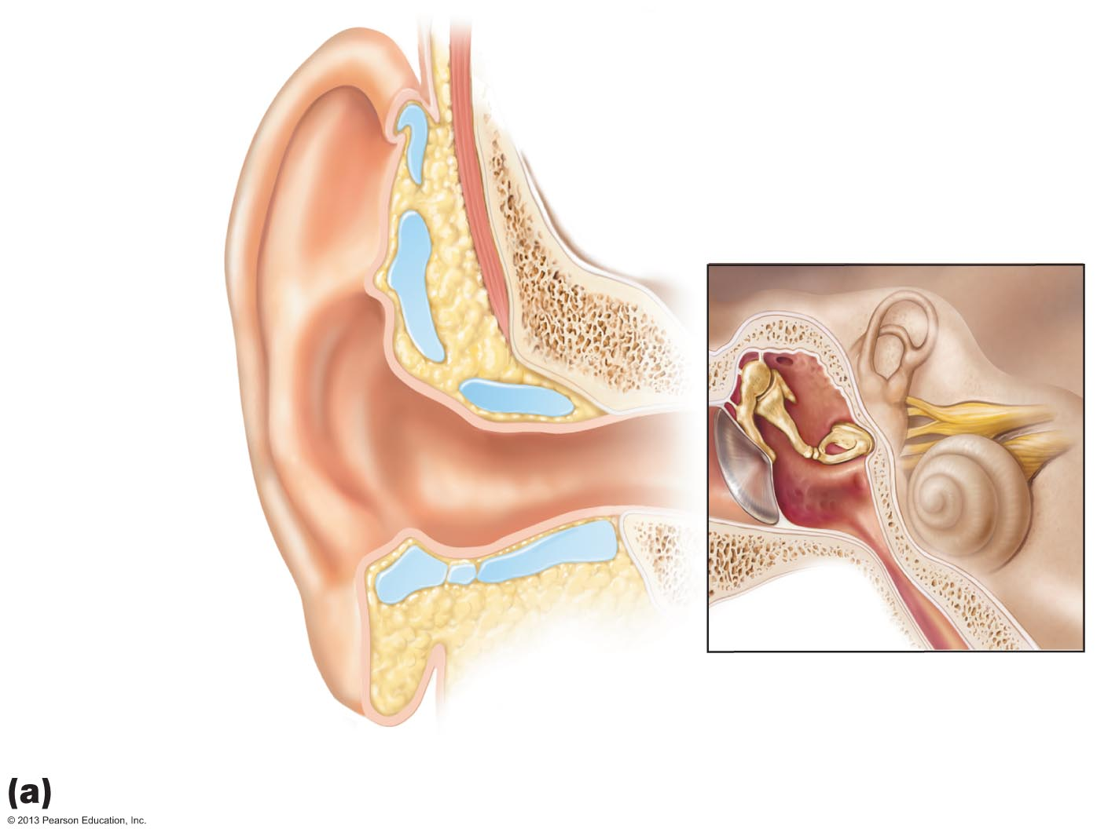
Figure 15.24a Structure of the ear.
Middle
ear
Internal ear
(labyrinth)
External
ear
Auricle
(pinna)
Helix
Lobule
External
acoustic
meatus
Tympanic
membrane
Pharyngotympanic
(auditory) tube
The three regions of the ear

Slide 35
External Ear
Auricle (pinna)Composed of
  Helix (rim); Lobule (earlobe)
  Funnels sound waves into auditory canal
External acoustic meatus (auditory canal)
  Short, curved tube lined with skin bearing hairs, sebaceous glands, and ceruminous glands
  Transmits sound waves to eardrum

Slide 36
External Ear
Tympanic membrane (eardrum)
  Boundary between external and middle ears
  Connective tissue membrane that vibrates in response to sound
  Transfers sound energy to bones of middle ear

Slide 37
Middle Ear (Tympanic Cavity)
A small, air-filled, mucosa-lined cavity in temporal bone
  Flanked laterally by eardrum
  Flanked medially by bony wall containing oval (vestibular) and round (cochlear) windows

Slide 38
Middle Ear
Epitympanic recess—superior portion of middle ear
Mastoid antrum
  Canal for communication with mastoid air cells
Pharyngotympanic (auditory) tube—connects middle ear to nasopharynx
  Equalizes pressure in middle ear cavity with external air pressure

Slide 39
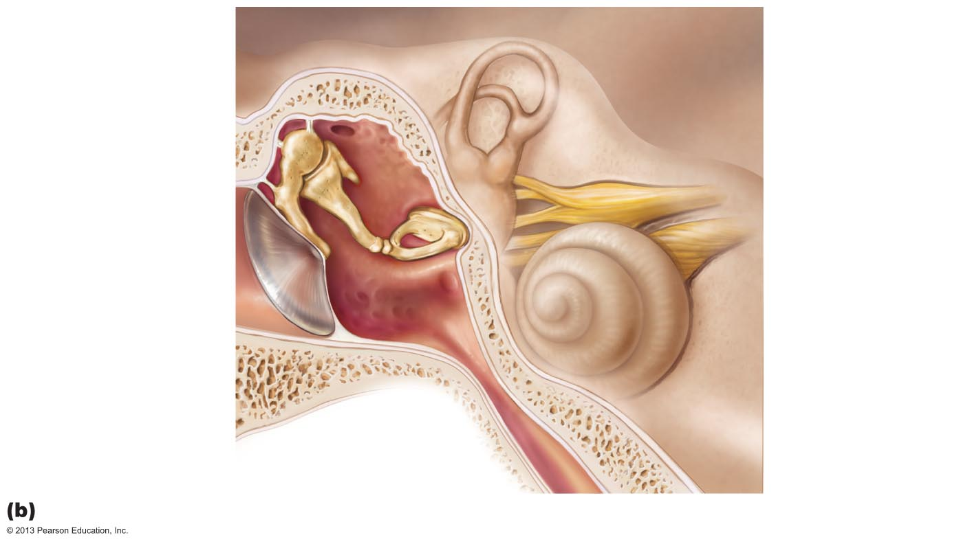
Figure 15.24b Structure of the ear.
Oval window
(deep to stapes)
Entrance to mastoid
antrum in the
epitympanic recess
Semicircular
canals
Malleus
(hammer)
Vestibule
Auditory
ossicles
Incus
(anvil)
Vestibular
nerve
Stapes
(stirrup)
Cochlear
nerve
Tympanic membrane
Cochlea
Round window
Pharyngotympanic
(auditory) tube
Middle and internal ear

Slide 40
Otitis Media
Middle ear inflammation
  Especially in children
    Shorter, more horizontal pharyngotympanic tubes
    Most frequent cause of hearing loss in children
  Most treated with antibiotics
  Myringotomy to relieve pressure if severe

Slide 41
Ear Ossicles
Three small bones in tympanic cavity: the malleus, incus, and stapes
  Suspended by ligaments and joined by synovial joints
  Transmit vibratory motion of eardrum to oval window
  Tensor tympani and stapedius muscles contract reflexively in response to loud sounds to prevent damage to hearing receptors

Slide 42
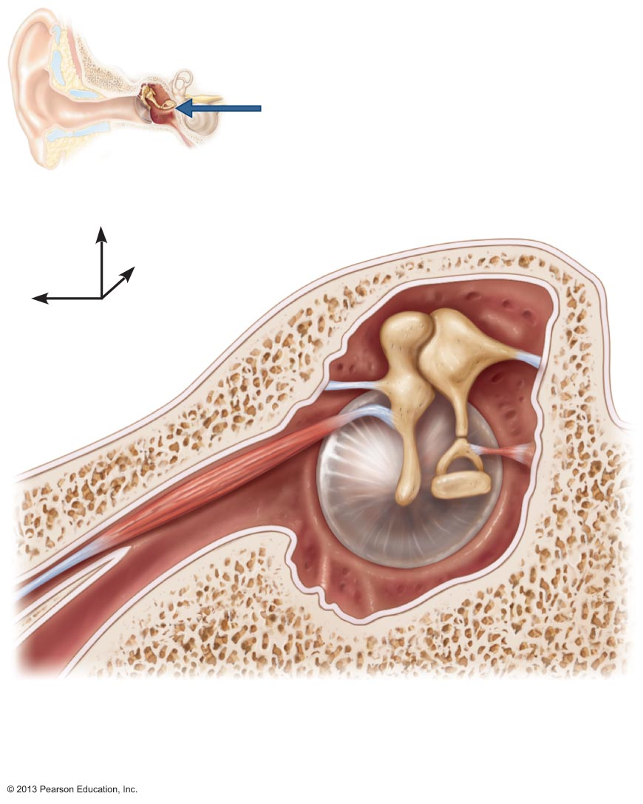
Figure 15.25 The three auditory ossicles and associated skeletal muscles.
View
Superior
Malleus
Incus
Epitympanic recess
Lateral
Anterior
Pharyngotym-
panic tube
Tensor
tympani
muscle
Tympanic
membrane
(medial view)
Stapes
Stapedius
muscle

Slide 43
Two Major Divisions of Internal Ear
Bony labyrinth
  Tortuous channels in temporal bone
  Three regions: vestibule, semicircular canals, and cochlea
  Filled with perilymph – similar to CSF
Membranous labyrinth
  Series of membranous sacs and ducts
  Filled with potassium-rich endolymph

Slide 44
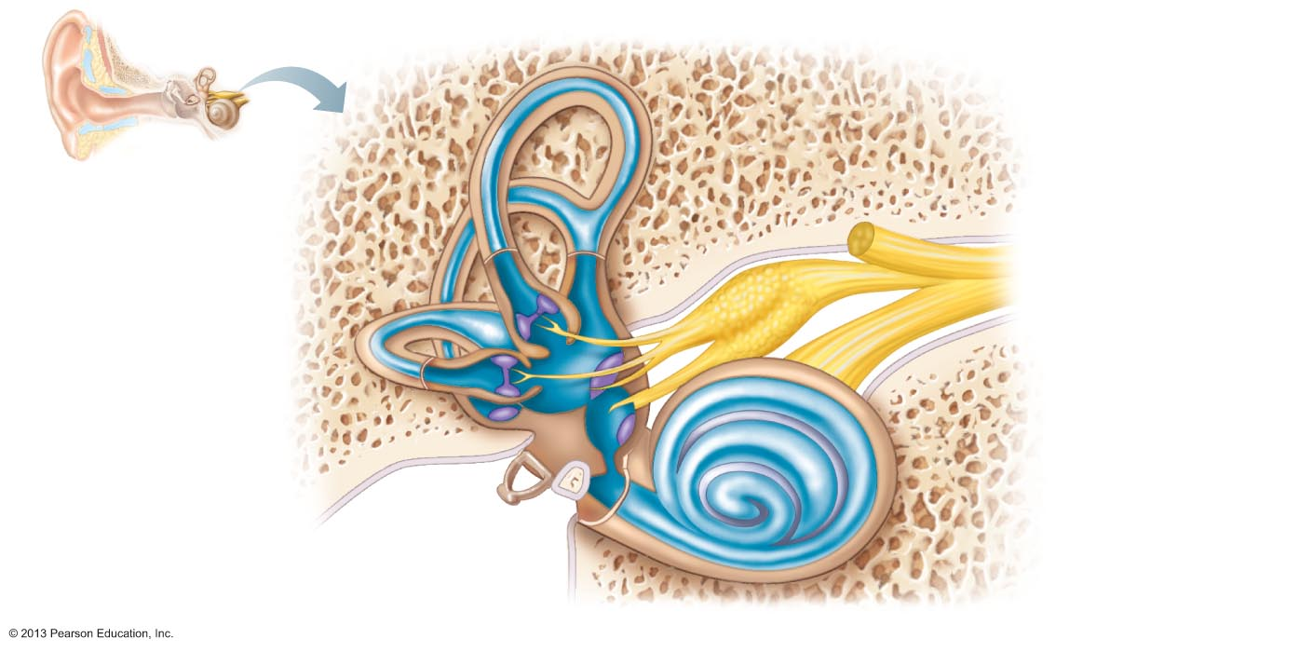
Figure 15.26 Membranous labyrinth of the internal ear.
Temporal
bone
Semicircular ducts
in semicircular
canals
Facial nerve
Vestibular nerve
Anterior
Superior vestibular
ganglion
Posterior
Inferior vestibular
ganglion
Lateral
Cristae ampullares
in the membranous
ampullae
Cochlear nerve
Maculae
Spiral organ
Utricle in
vestibule
Cochlear duct
in cochlea
Saccule in
vestibule
Stapes in
oval window
Round window

Slide 45
Vestibule
Central egg-shaped cavity of bony labyrinth
Contains two membranous sacs
  Saccule is continuous with cochlear duct
  Utricle is continuous with semicircular canals
These sacs
  House equilibrium receptor regions (maculae)
  Respond to gravity and changes in position of head

Slide 46
Semicircular Canals
Three canals (anterior, lateral, and posterior) that each define ⅔ circle
  Lie in three planes of space
Membranous semicircular ducts line each canal and communicate with utricle
Ampulla of each canal houses equilibrium receptor region called the crista ampullaris
  Receptors respond to angular (rotational) movements of the head

Slide 47
Figure 15.26 Membranous labyrinth of the internal ear.
Temporal
bone
Semicircular ducts
in semicircular
canals
Facial nerve
Vestibular nerve
Anterior
Superior vestibular
ganglion
Posterior
Inferior vestibular
ganglion
Lateral
Cristae ampullares
in the membranous
ampullae
Cochlear nerve
Maculae
Spiral organ
Utricle in
vestibule
Cochlear duct
in cochlea
Saccule in
vestibule
Stapes in
oval window
Round window

Slide 48
The Cochlea
A spiral, conical, bony chamber
  Size of split pea
  Extends from vestibule
  Coils around bony pillar (modiolus)
  Contains cochlear duct, which houses spiral organ (organ of Corti) and ends at cochlear apex

Slide 49
The Cochlea
Cavity of cochlea divided into three chambers
  Scala vestibuli—abuts oval window, contains perilymph
  Scala media (cochlear duct)—contains endolymph
  Scala tympani—terminates at round window; contains perilymph
Scalae tympani and vestibuli are continuous with each other at helicotrema (apex)

Slide 50
The Cochlea
The "roof" of cochlear duct is vestibular membrane
External wall is stria vascularis – secretes endolymph
"Floor" of cochlear duct composed of
  Bony spiral lamina
  Basilar membrane, which supports spiral organ
The cochlear branch of nerve VIII runs from spiral organ to brain

Slide 51
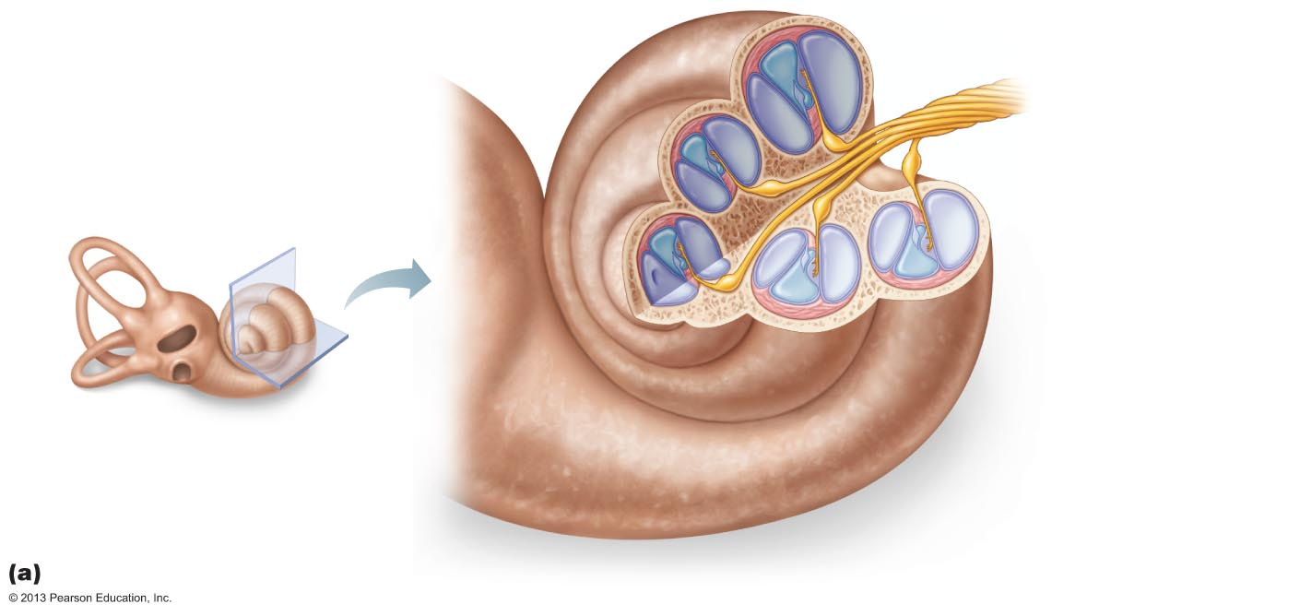
Figure 15.27a Anatomy of the cochlea.
Helicotrema
at apex
Modiolus
Cochlear nerve,
division of the
vestibulocochlear
nerve (VIII)
Spiral ganglion
Osseous spiral lamina
Vestibular membrane
Cochlear duct
(scala media)

Slide 52
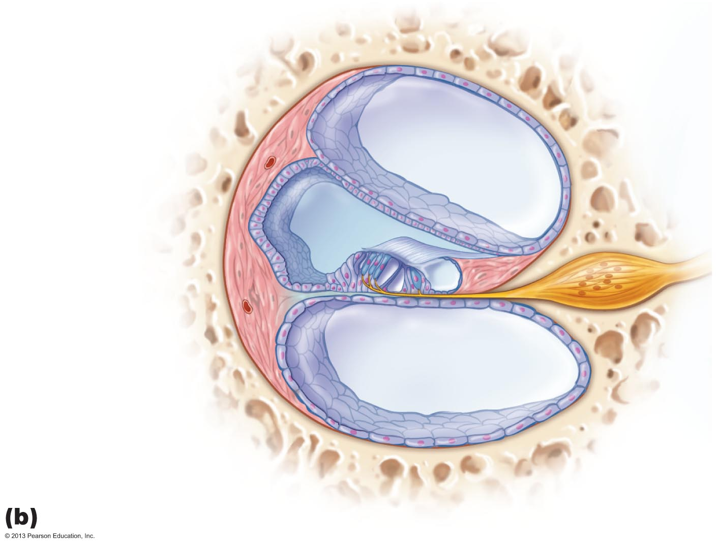
Figure 15.27b Anatomy of the cochlea.
Vestibular membrane
Osseous spiral lamina
Tectorial membrane
Spiral
ganglion
Scala
vestibuli
(contains
perilymph)
Cochlear duct
(scala media;
contains
endolymph)
Stria
vascularis
Spiral organ
Scala
tympani
(contains
perilymph)
Basilar
membrane

Slide 53
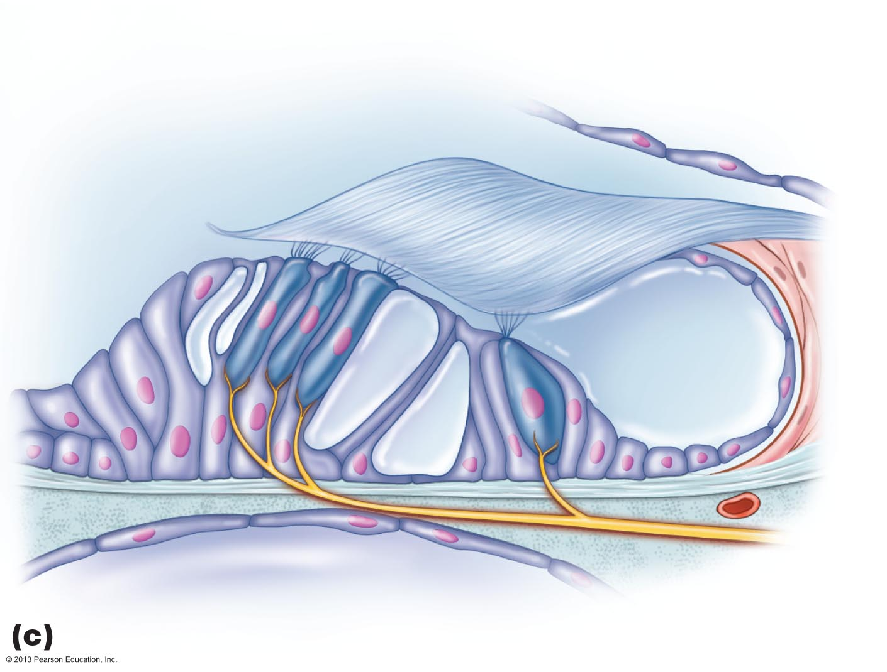
Figure 15.27c Anatomy of the cochlea.
Tectorial membrane
Inner hair cell
Hairs (stereocilia)
Afferent nerve
fibers
Outer hair cells
Supporting cells
Fibers of
cochlear
nerve
Basilar
membrane

Slide 54
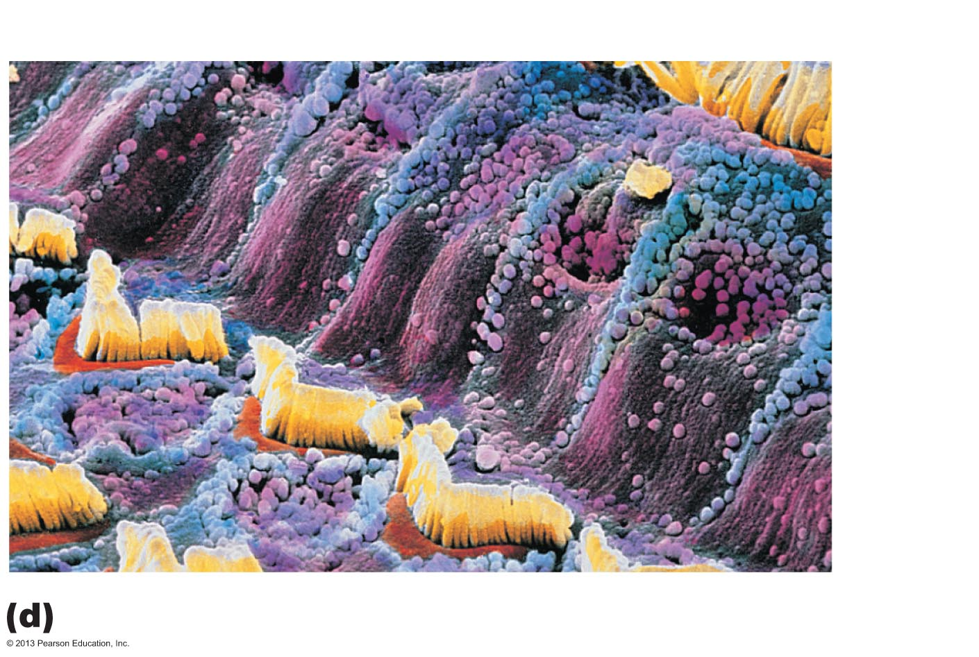
Figure 15.27d Anatomy of the cochlea.
Inner
hair
cell
Outer
hair
cell

